Slide 1
August 2021

Slide 2
Advisor Mentorship Program website
www.advisormentorship.com/login
Recording of this months AMP call / Power Point Presentations
Recent updates on AMP site below
Mastermind Call Archive
Top Advisor Staffing/Hiring employees
Systems Work, People Fail (5 Resources to help grow advisors Annuity Business)
Articles
Robert Shiller Q3 Market Forecast 2021 with Laurence Black
5 Steps to defuse the retirement savings tax time bomb
Coaching
Virtual Advisor log in portal for users
Operations
Syncing Catalyst leads to your Hubbard dashboard
Production Track (client tracker/business numbers)
Point-of-Sale
How to use this calculator at point of sale
Product Performance
July 2021 AMP Vol. report
Laurence Black Replay
Index Ratings / Vol. Control Indices Guide
Comment Section for members

Slide 3
Referral BONUS!

Slide 4
Patrick Kelly
https://tax-freeretirement.com/insiders-package.php
PROMO CODE: imk (capitalized IMK)
Once member of Insiders program, Use the Promo code : Insiders695
Books will be $6.95 each.

Slide 5
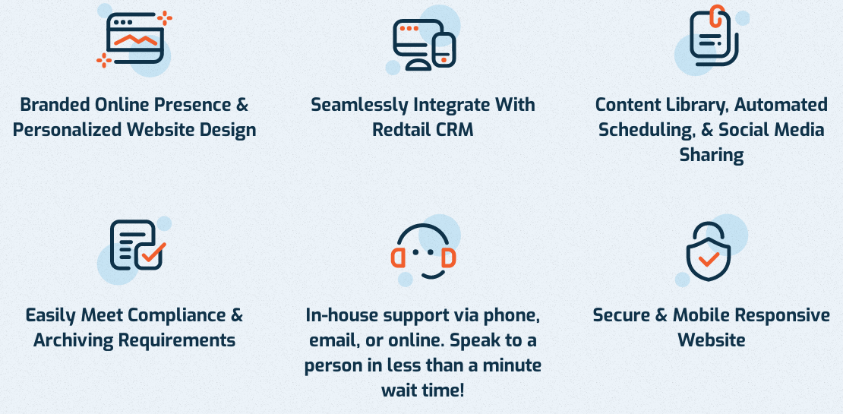
Websites
https://www.advisorwebsites.com/insurmark

Slide 6
Catalyst 90 day accelerator program
Hit Refresh first if you do not see this and it should pop up

Slide 7
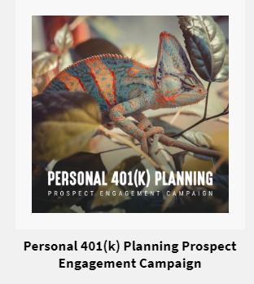
Catalyst –Top Performers

Slide 8
Catalyst Social Security Conversations

Slide 9
Roth Conversion Business Builder
Roth IRA conversion biz builder
Ed Slott recording IRAhelp.com promo code is Insurmark (July)
20 min spotlight - Roth Analyzer recording
For personalization, I will need the following below from you.
Please upload & send me the following below via JPEG or PNG file formats, limit of 5MB for file size:
Advisor Business Logo
Advisor Photo
Advisor Video which is optional (if you want to send me a quick 20 sec. intro video to the roth conversion video, we can add at the beginning): has to be MP4 or MOV file format, max file size limit is 64 MB.
Advisor name:
Advisor Business Name:
Advisor Business Phone Number
Advisor Business Website:

Slide 10
Podcasting
https://topadvisormarketing.com/insurmark/
20 minute spotlight – Podcasting & Social Media replay here https://attendee.gotowebinar.com/recording/3115556768172445186

Slide 11
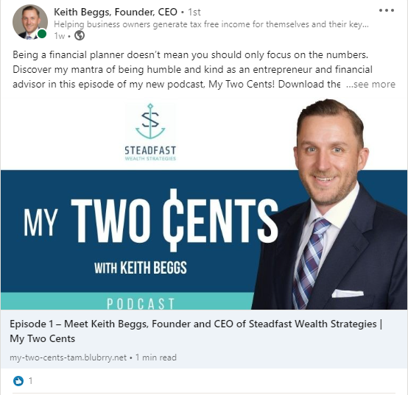
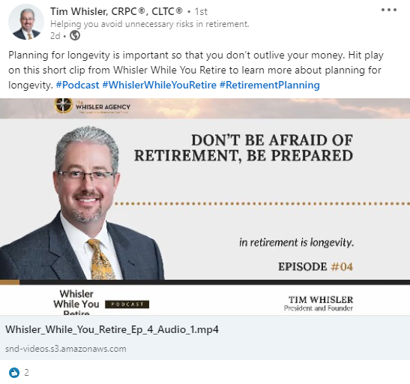
Micro-Influence System

Slide 12
Virtual Advisor (Webinar Partner)
Cost - $1,750/month + Ad spend per webinar ($1000-$1500/webinar)
Average cost per registrant for my advisors $29/registrant
42% National Average of registrants attend
20-40% appointments from webinar book (depends on advisor)
Goal
10 appointments per webinar
Cost per appointment $100-150
Convert 3 clients per webinar

Slide 13
Virtual Advisor (One on One coaching call)
JH team of advisors interested in or currently doing Virtual Advisor
1 hour recording on how virtual advisor works
New advisors wanting to attend Friday’s call to do Q/A, request the link from me
For members:
First Appointment, Key Terms, Q/A with Al
Recording with Al (35 min.)
InsurMark Retirement Calculator through Virtual Advisor
Calculator Advisors can use at point of sale (53 min.)
How to use Calculator at point of sale (33 min.)
Click this link to purchase calculator for $40/month

Slide 14
IMSSA Monthly webinars / Podcasts
Past Monthly webinars:
https://members.insurmarksalessuccessacademy.com/monthly-training/
July Monthly call Replay
Chad’s Point Of Sale ZOOM presentation for clients:
https://members.insurmarksalessuccessacademy.com/lessons/chads-virtual-appointment-process/
Podcasts:
https://www.insurmarksalessuccessacademy.com/podcast

Slide 15
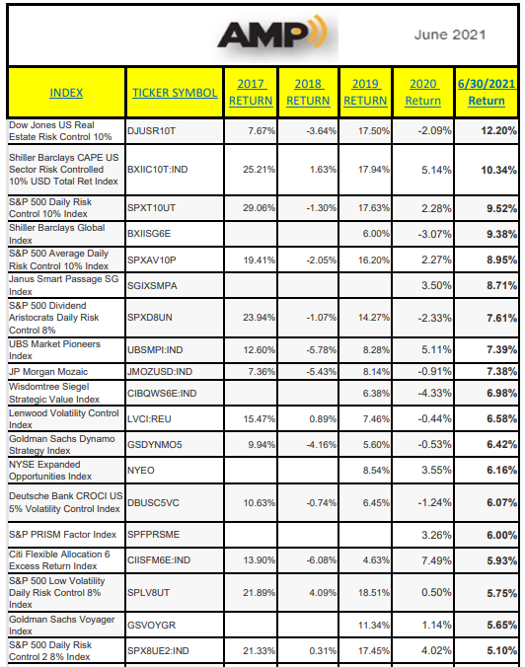
AMP July Vol Control Report
Notes:
S&P 500 has done 16.13% during t his same timeframe

Slide 16
HOT Products / Indexes

Slide 17
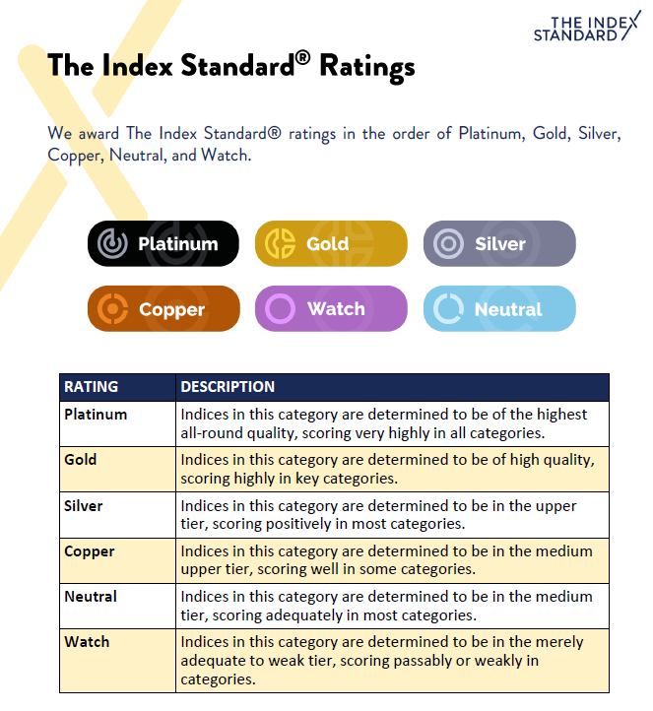
The Index Standard Ratings

Slide 18
Top performers over last 3 years 6/2018 - 6/2021

Slide 19
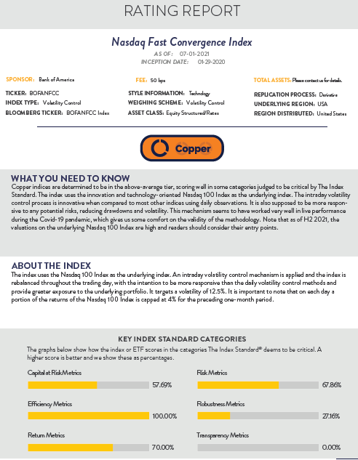
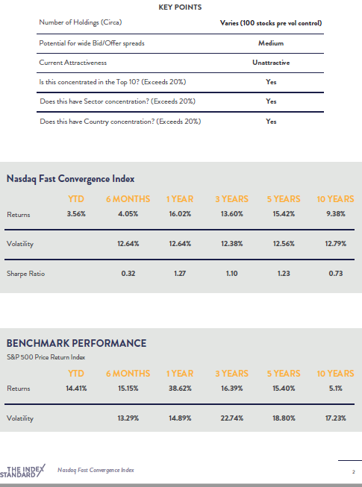
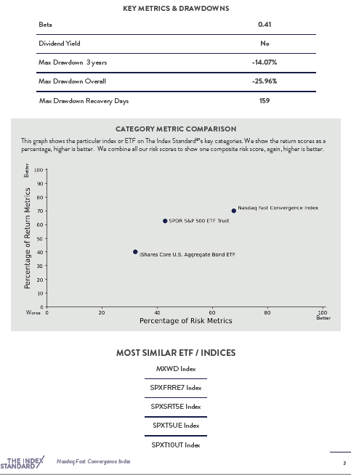
Nasdaq Fast Convergence Index - Athene

Slide 20
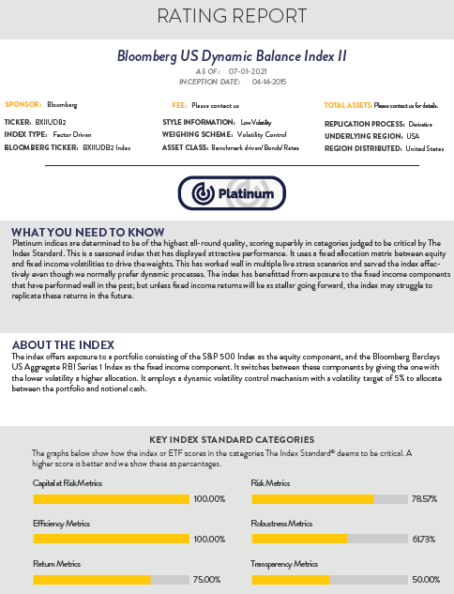
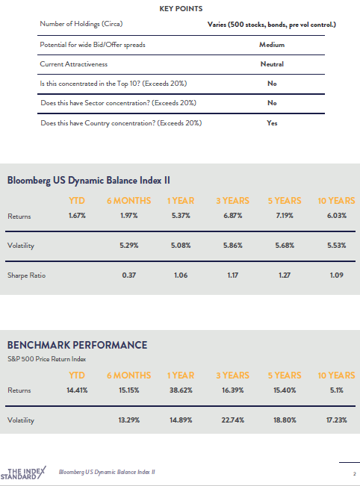
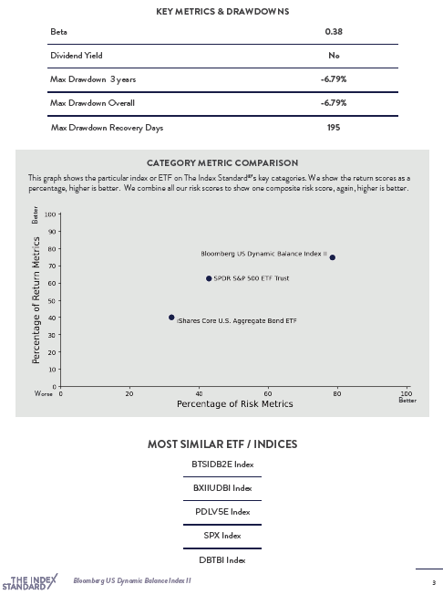
Bloomberg US Dynamic Balance Index II - Allianz

Slide 21
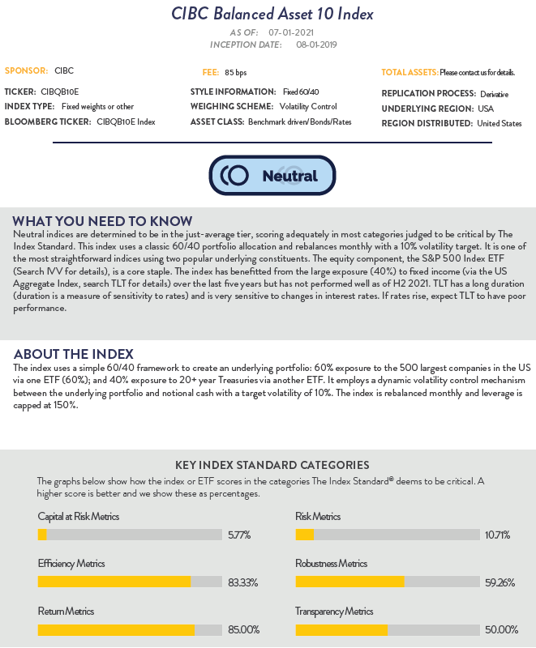
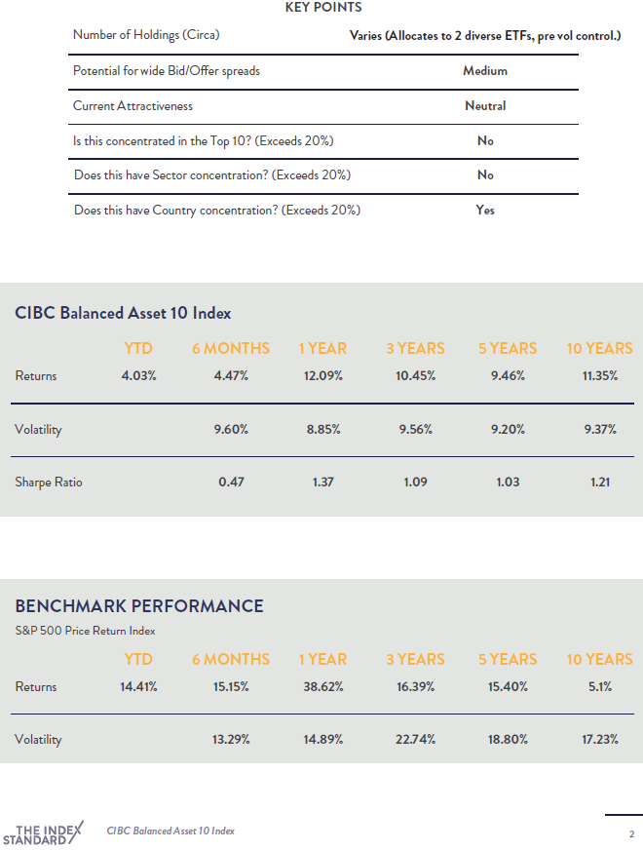
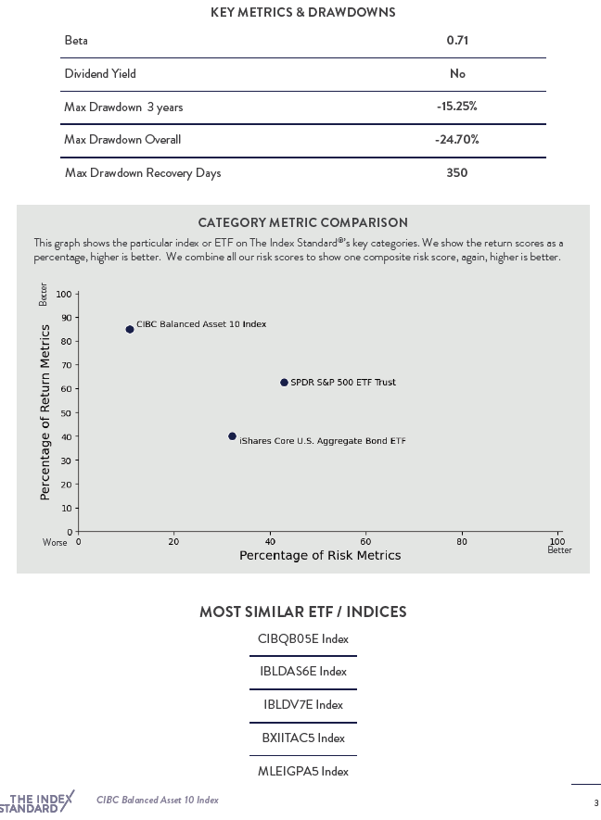
CIBC Balanced Asset 10 Index – F&G

Slide 22
How to access

Slide 23
Webinars this month
Virtual Advisor call with Al – Fridays @ 10:00 AM CST
August 6th @ 10:30 AM CST – InsurMark Catalyst First Friday Office Hours (monthly) BEST PRACTICES
Register here: Click Here to register
Social Security Plus Thursday recordings within Hubbard Ultimate SS Planning Biz Builder Tile
August 10th @ 9:00 AM CST, Simplicity & Allianz Life Sales Forum:
Register Here
Family Reunion Announcement: www.insurmark.net/familyreunion

Slide 24
Family Reunion Qualifier
www.insurmark.net/familyreunion

Slide 25
AMP
Use your AMP Portal www.advisormentorship.com
Make sure you are using your client tracker / know your numbers
Invest in your practice – get with me for marketing programs
My calendar link: https://go.oncehub.com/jeremyhouser

Slide 26
Quote of the day

