Slide 1
Bond alternative

Slide 2
Sound Familiar?

Slide 3
What Is the 60/40 Portfolio (And Should You Have One)?
https://smartasset.com/investing/60-40-portfolio
Sep 2019

Slide 4
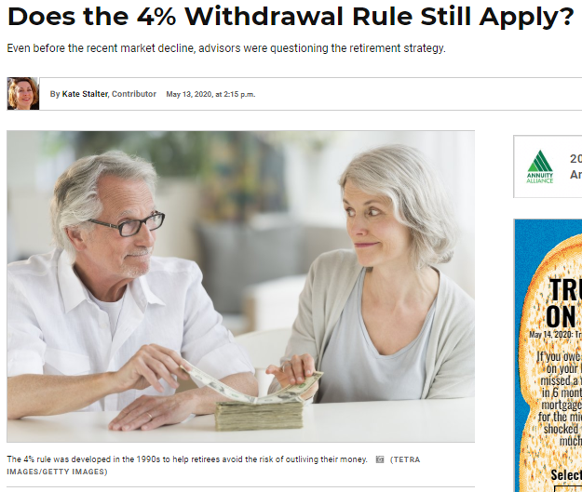
Does the 4% Withdrawal Rule Still Apply?
https://money.usnews.com/investing/financial-advisors/articles/does-the-4-withdrawal-rule-still-apply-to-todays-retirees May 13, 2020

Slide 5
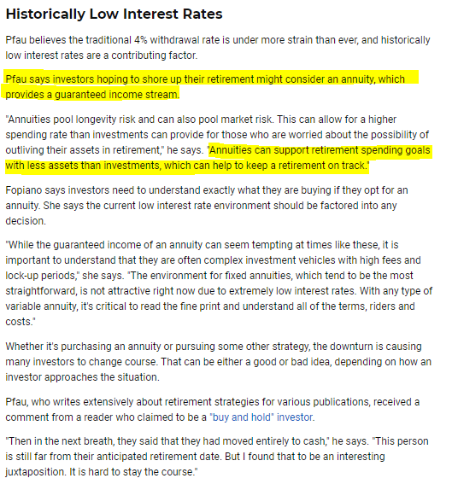
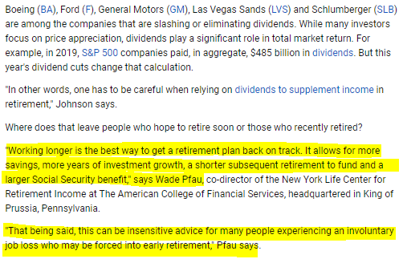
Does the 4% Withdrawal Rule Still Apply?
https://money.usnews.com/investing/financial-advisors/articles/does-the-4-withdrawal-rule-still-apply-to-todays-retirees May 13, 2020

Slide 6
Dr. Wade Pfau
https://retirementresearcher.com/
Notes:
DR WADE PFAU
Seven portfolio changing reasons why income planning is different from wealth accumulation.
How longevity risk changes portfolio management.
How to give clients a 35% improvement in their retirement standard of living by lowering risk and increasing their legacy through “risk pooling.”
4 L’s of financial planning for retirement.
The 21st century approach to asset allocation. One of the big points Wade makes is his research that the efficient income frontier is really just two assets: stocks and annuities. He goes so far as to show how much better off the consumer’s income and net worth look by using this two asset class model. Wade is not the first one to bring this to light over the last several years add to the Ibbotson, Shiller and DALBAR research about why annuities work better than bonds.

Slide 7
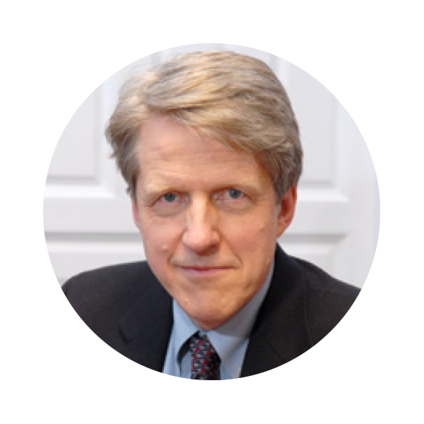
Credible Resource & American Economist
Roger Ibbotson won the Markowitz Award Prize for 2015 Best Article in Journal of Investment Management selected by Nobel Prize Winners Harry M. Markowitz, Robert C. Merton, Myron S. Scholes & William F. Sharpe
Robert Shiller has been awarded the 2013 Nobel Prize in Economic Sciences.

Slide 8
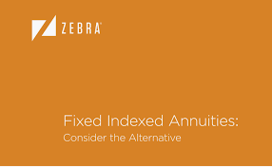
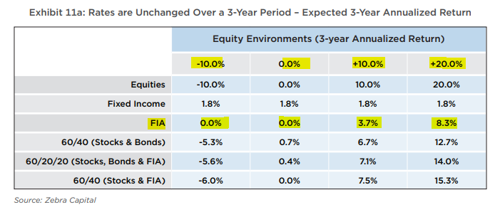
Ibbotson White Paper

Slide 9
Mr. & Mrs. Clark
Mr. Clark is 65 & Mrs. Clark is 54
Currently they are pulling 4% ($12K) from their $300K bond fund
Main concerns with this asset for the Clarks are:
Reduce market risk
Reduce fees on the asset
Still receive cash flow without the risk of outliving their money

Slide 10
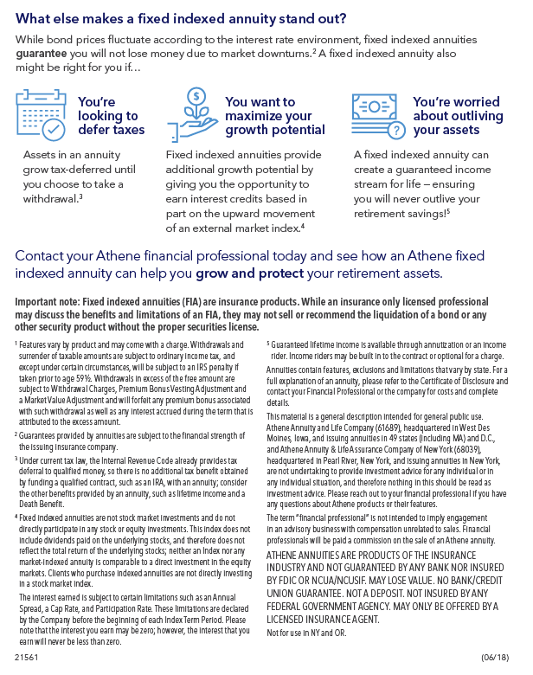
When Interest rates rise, think Annuities!

Slide 11
Athene Agility
10% liquidity available IMMEDIATELY
NO Fees associated with the contract
Good accumulation opportunity with their par rates and diversified strategies
Opportunity to have a guaranteed stream of income for the rest of both of your lives
20% Benefit Base Bonus that can be used for Legacy or Income in the future

Slide 12
Bond Alternative

Slide 13
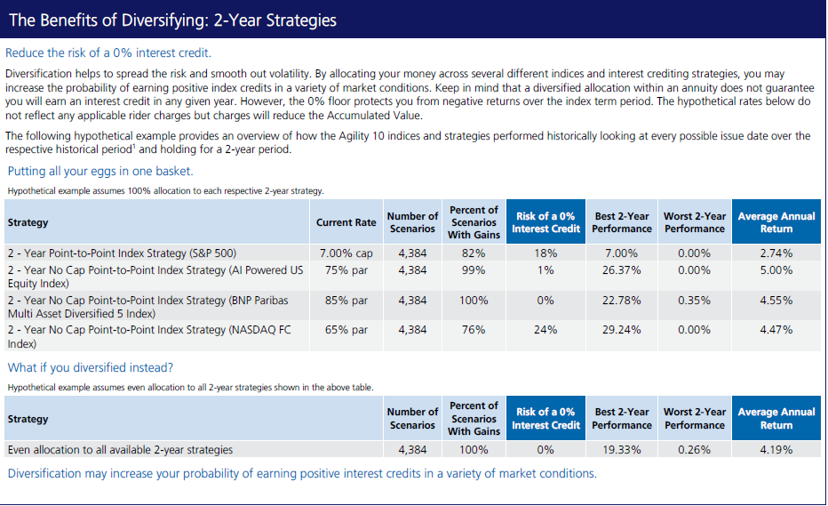
Agility Strategies

Slide 14
FOR AGENT

